Slide 1
Recycle model results 30/12/21

Slide 2
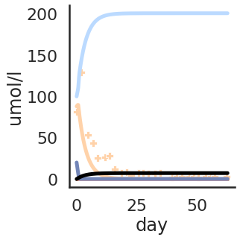
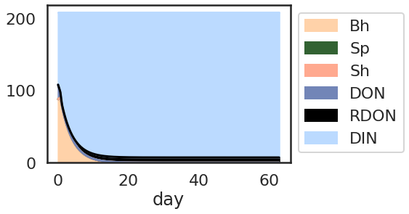
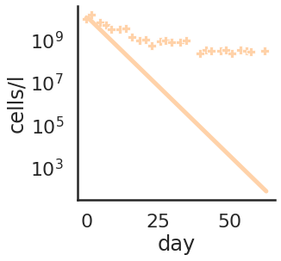
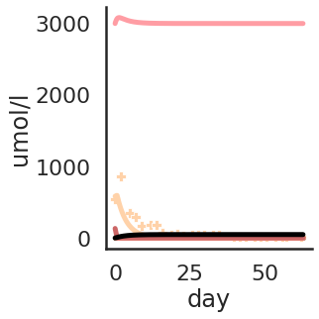
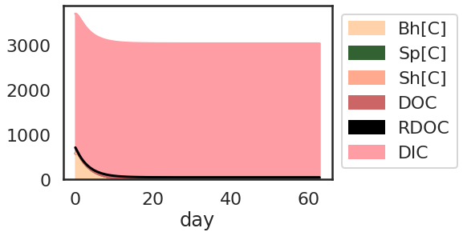
HET only

Slide 3
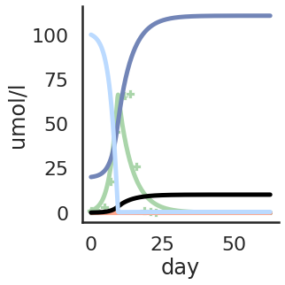
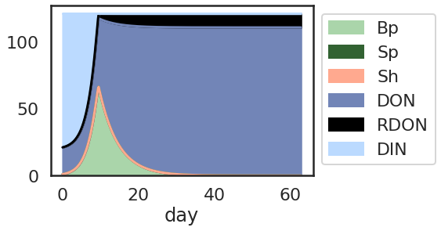
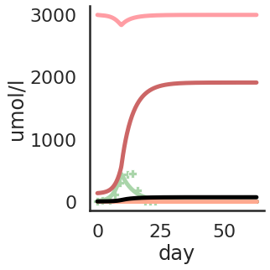
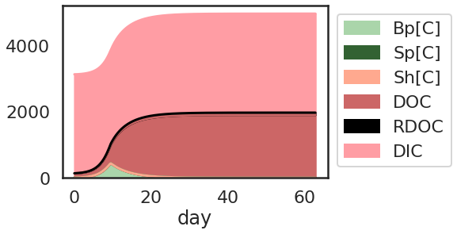
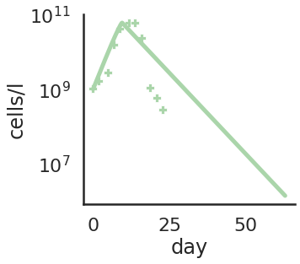
PRO only

Slide 4
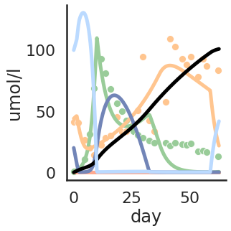
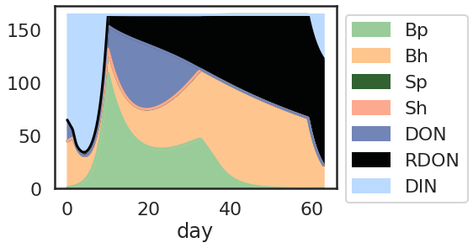
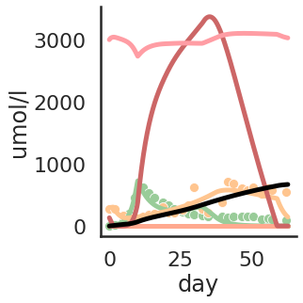
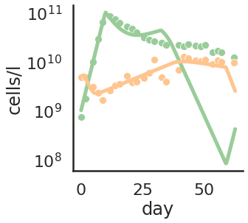
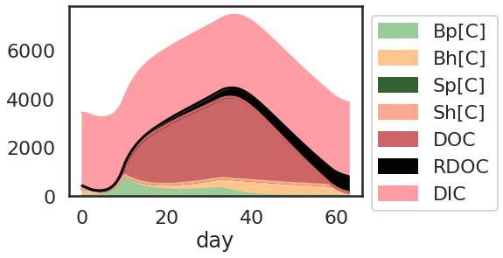
Co culture

Slide 5
Multiple runs
Param sensitivity – changing 1 param at a time
Disable mechanism – disable a single mechanism at a time
Sensitivity/monte carlo – run multiple combinations based on param boundaries
Differential evolution – look for a solution minimizing error vs measurements

Slide 6
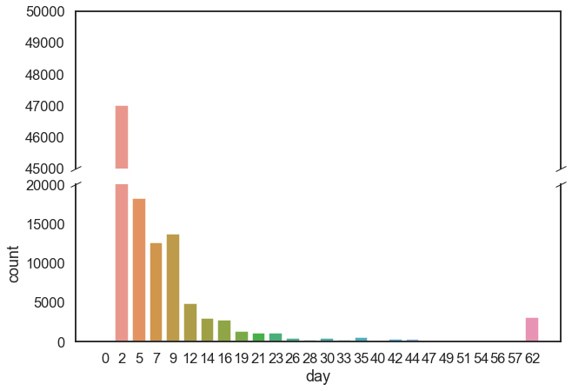
Most monte carlo runs end with system collapse
Category | Simulations
Negative values in results | 8539
System collapse (both biomass < 0.1umol N/L from day 5) | 60590
Valid simulations | 43341
Total | 112470
Last day in which either biomass > 0.1 umol/L
Number of simulations

Slide 7
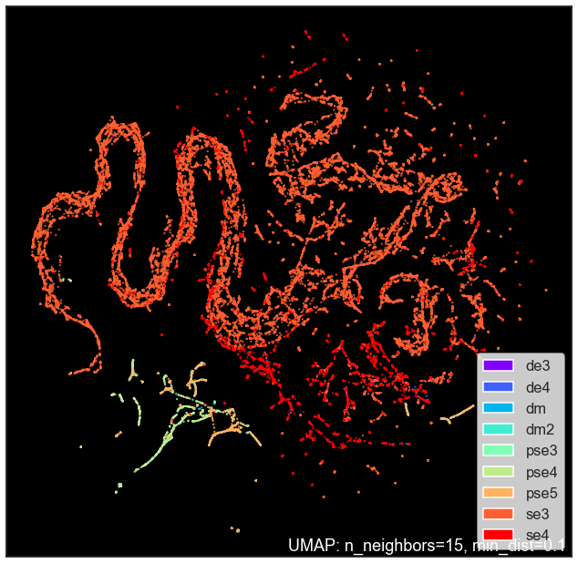
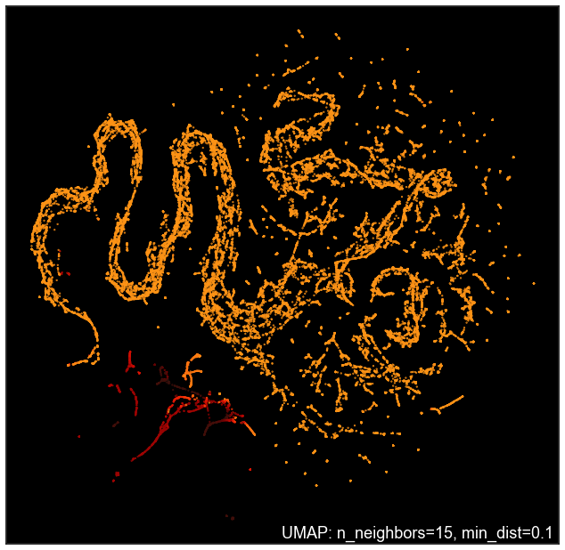
UMAP (only viable simulations)
Colored by simulation type
Colored by log(error) – darker is lower error

Slide 8
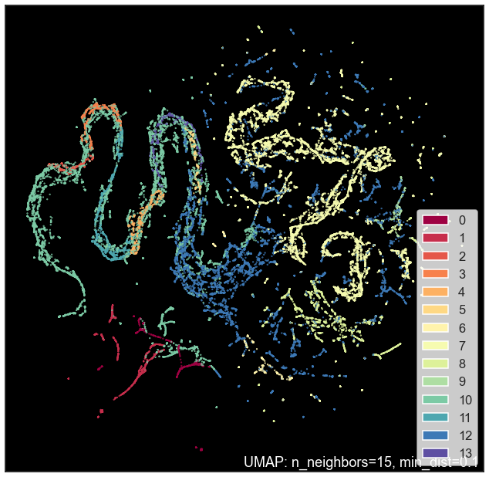
Clustering

Slide 9
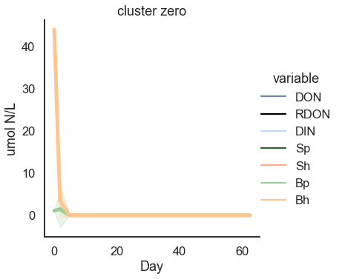
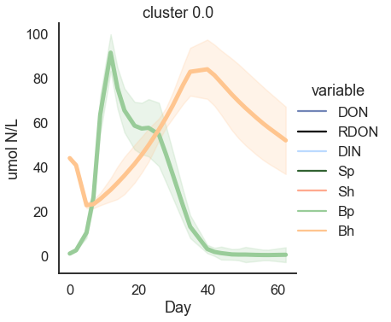
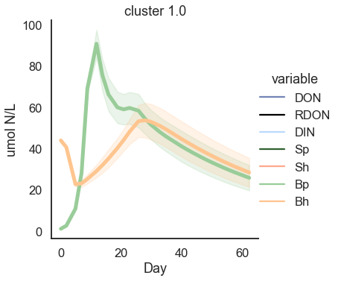
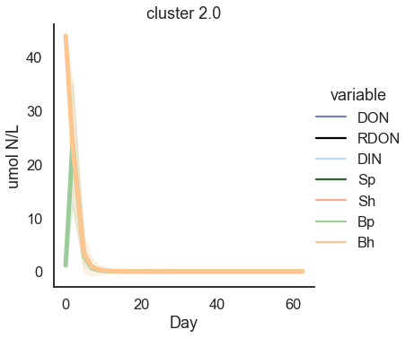
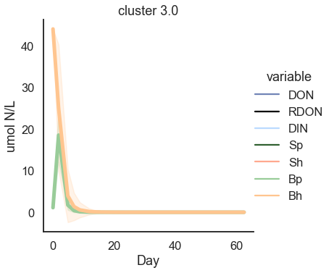
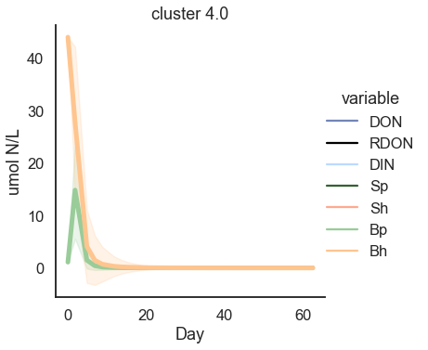
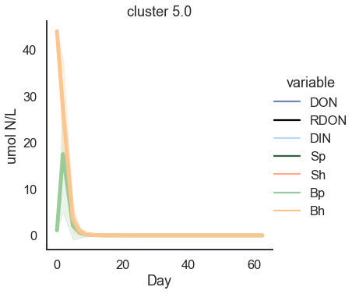
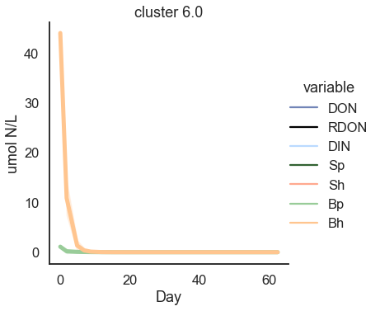
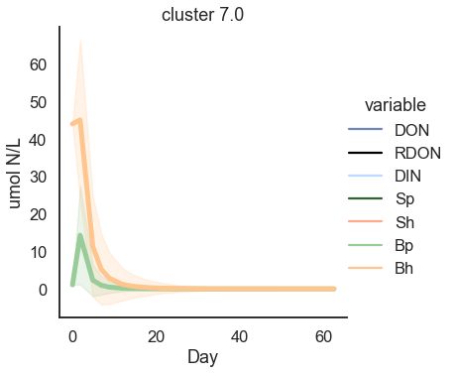
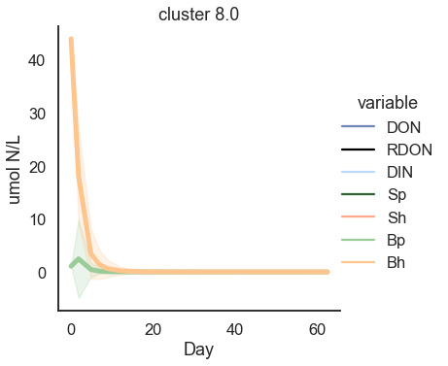
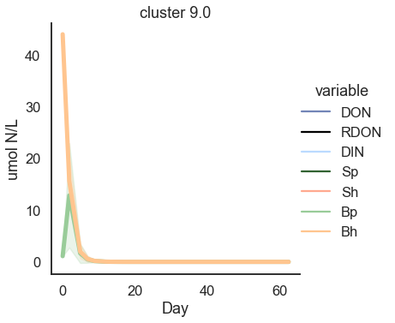
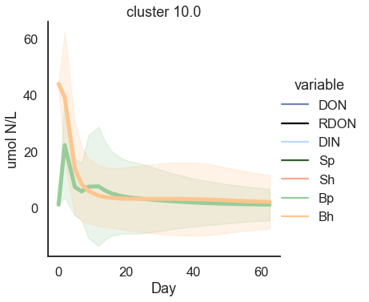
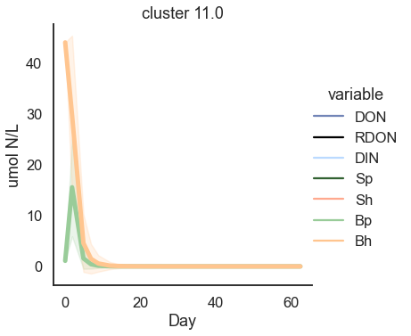
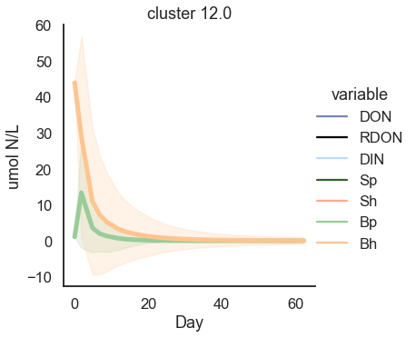
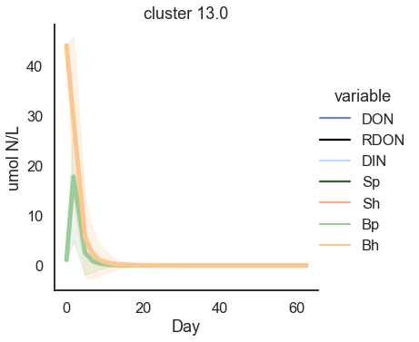

Slide 10
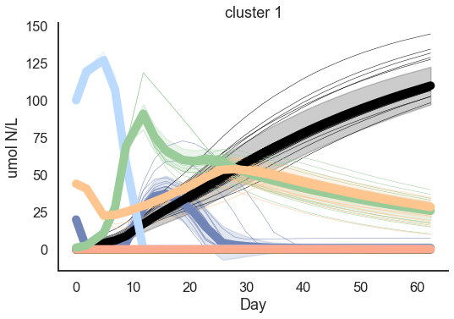
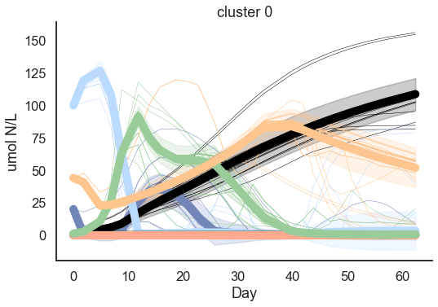
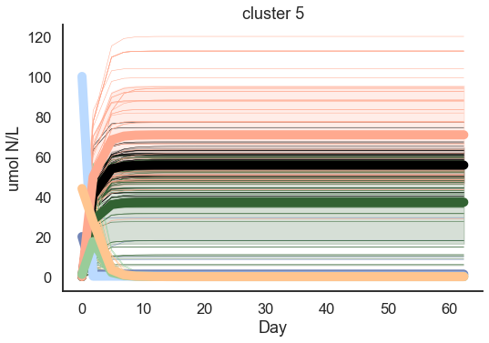
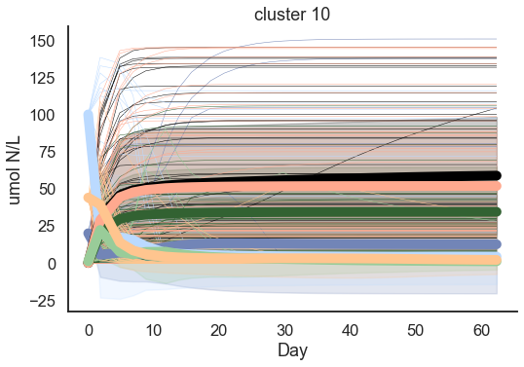

Slide 11
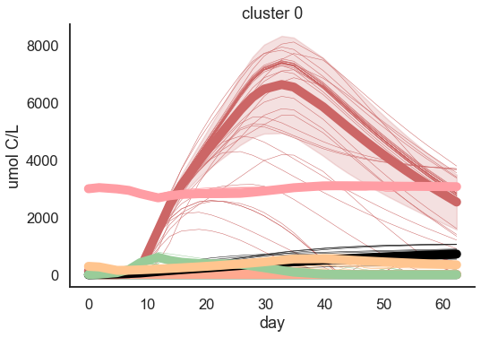
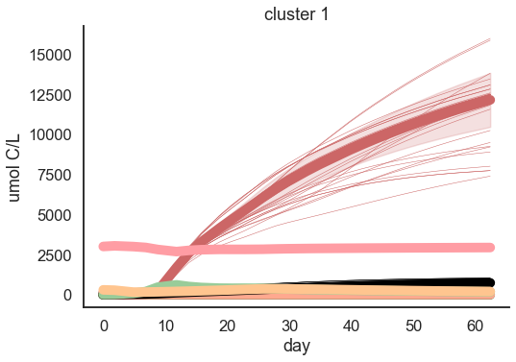
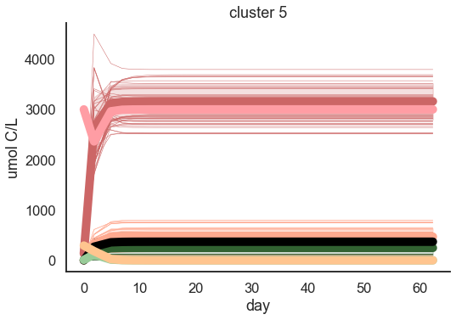
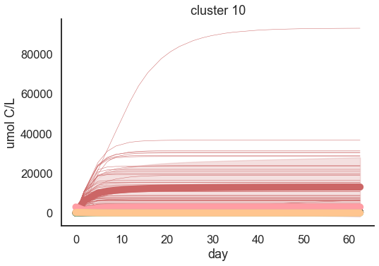

Slide 12
The model
CO₂
overflow
Exudation/respiration
DIC
DIN
Respiration
uptake
uptake
uptake
Exudation/Respiration
Respiration
overflow
P
exudation
H
DOC
DON
death
death
overflow
uptake
release
breakdown
inhibition
ROS
release
Promote/inhibit death
Signal_{H}
Promote/inhibit death
release
Signal_{P}

Slide 13
Model Configurations To Compare
Minimal
Add Exudation & Overflow
Add Signaling & Detoxification
CO₂
CO₂
CO₂
overflow
overflow
respiration
Exudation/respiration
Exudation/respiration
DIC
DIN
DIC
DIN
DIC
DIN
Respiration
uptake
Respiration
uptake
Respiration
uptake
uptake
uptake
Respiration
uptake
uptake
Exudation/Respiration
uptake
uptake
Exudation/Respiration
Respiration
Respiration
overflow
Respiration
overflow
P
DOC
DON
H
P
exudation
H
P
exudation
H
death
death
death
DOC
DON
death
death
DOC
DON
death
uptake
overflow
uptake
overflow
uptake
release
breakdown
inhibition
ROS
release
Promote/inhibit death
Signal_{H}
Promote/inhibit death
release
Signal_{P}

Slide 14
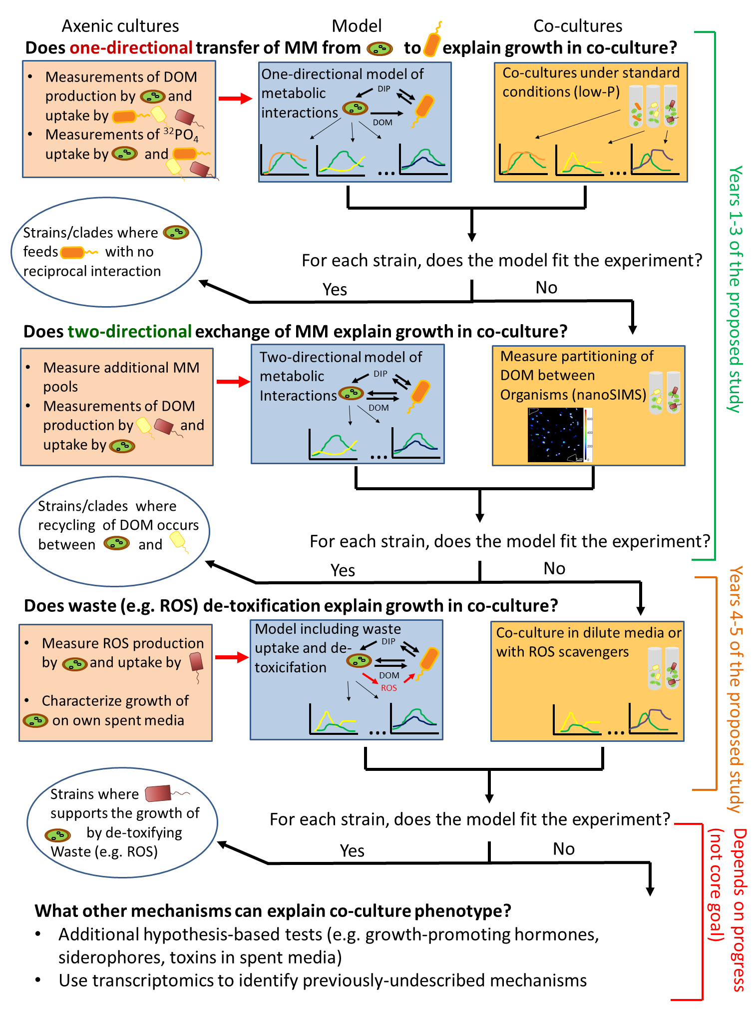

Slide 16
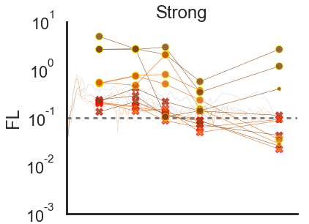
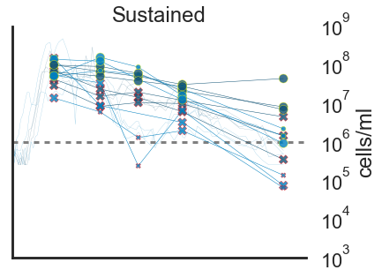
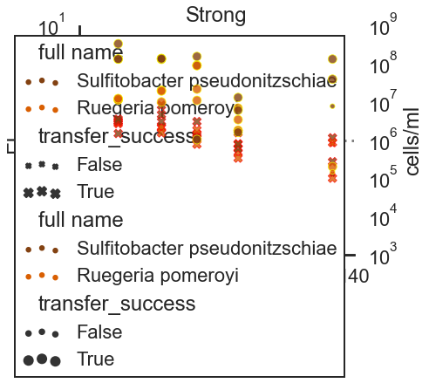
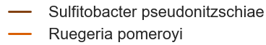
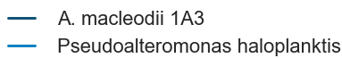
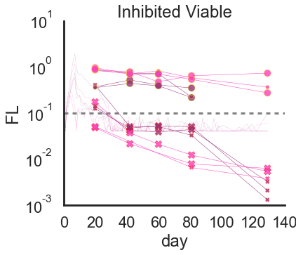
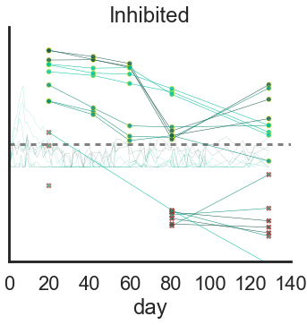



MED4 Not Viable
MED4 Viable
Heterotroph Not Viable
Heterotroph Viable

Slide 17




Sustained
Strong
Inhibited Viable
Inhibited + Axenic
Heterotroph Not Viable
MED4 Not Viable
Heterotroph Viable
MED4 Viable

Slide 18
Possible outline
Define model configurations
Run differential evolution on each 10cc results
FACS only? FL?
Using each configuration
N replicates
Analyze results
Which of the measurements could be explained by the model

Slide 19
Question
It seems that some settings should influence multiple parameter values. For example, R_{i} (C/N ratio), Q_{i} (cell quota), cell sizes (currently implicit). Should we define ‘super parameters’ that influence the allowed distributions of other parameters. What would these parameters and values be?

Slide 20
Next Steps
What is the relevant range of params
Analyze the runs to see what range of params causes negative simulation/timeouts and what range of params causes quick collapse
Run genetic optimization (differential evolution) to fit against each o the FACS results of 10CC experiment
Following configurations
Disable signaling and ROS
Disable overflow and exudation

